Slide 1



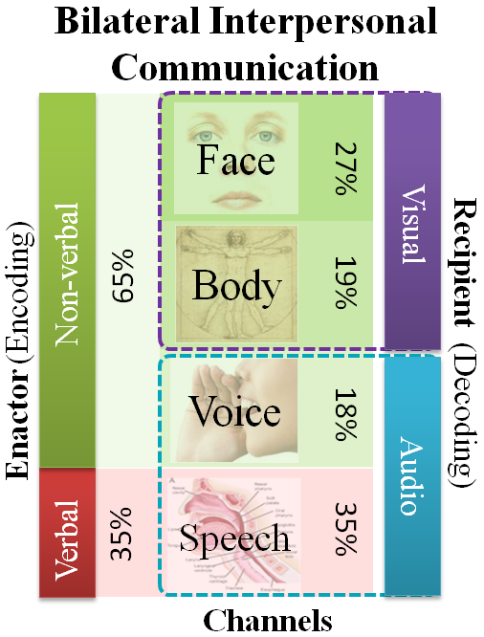
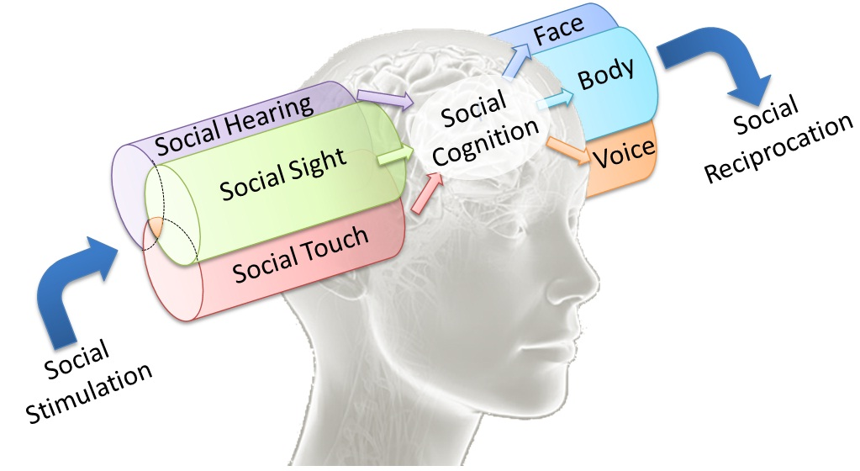
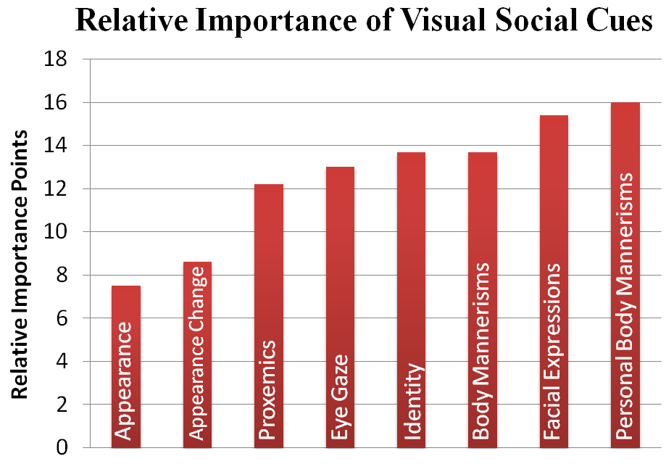
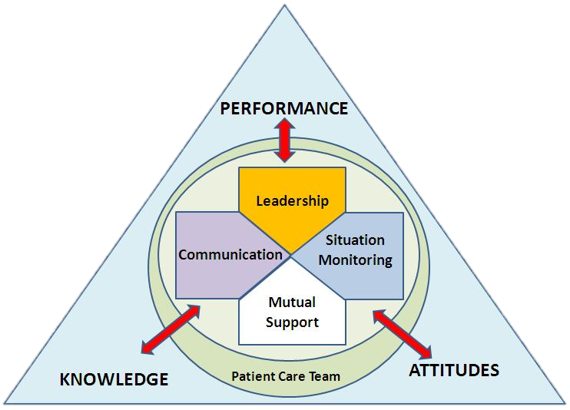
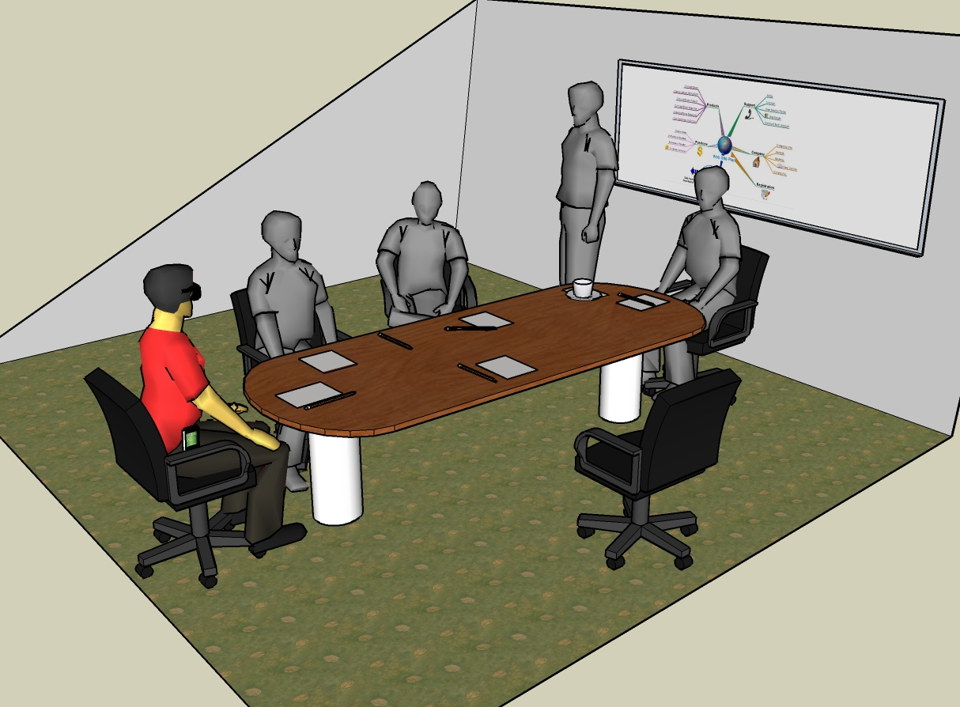
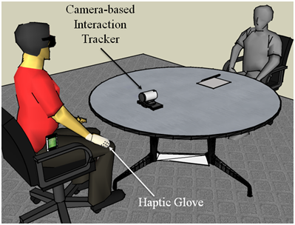
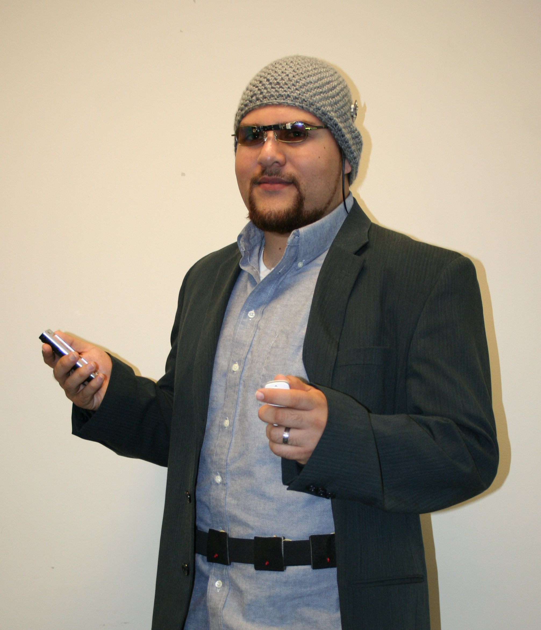
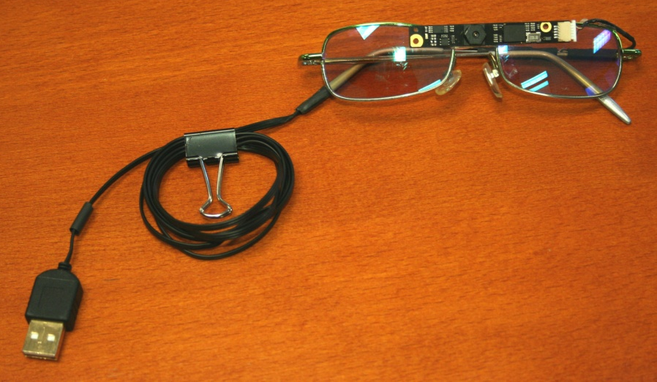
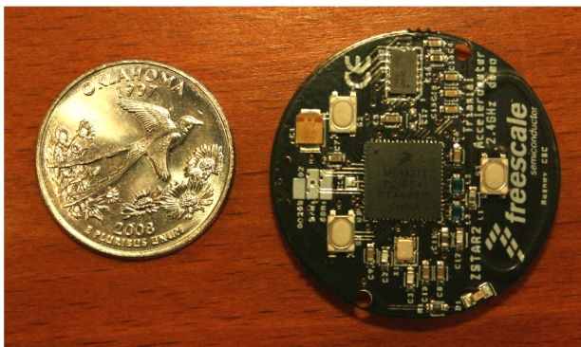

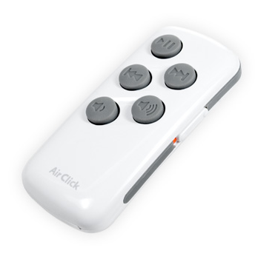
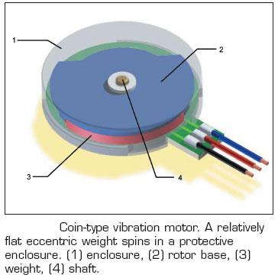
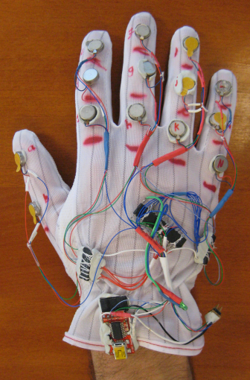
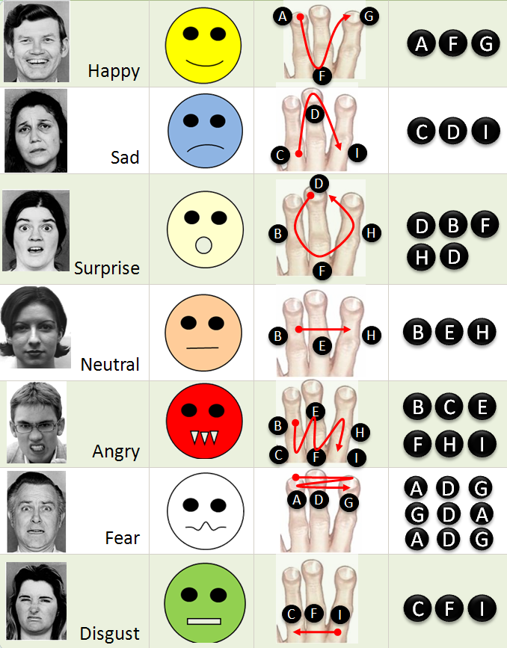
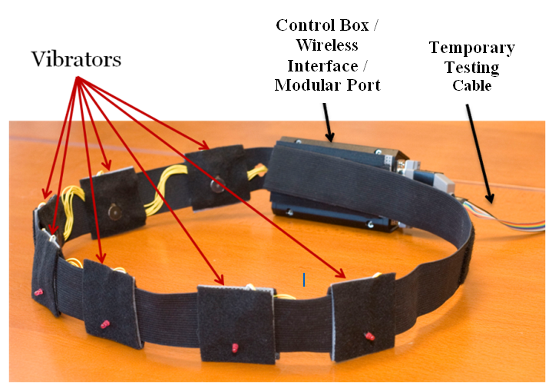
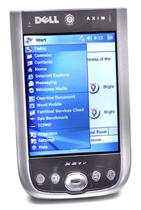
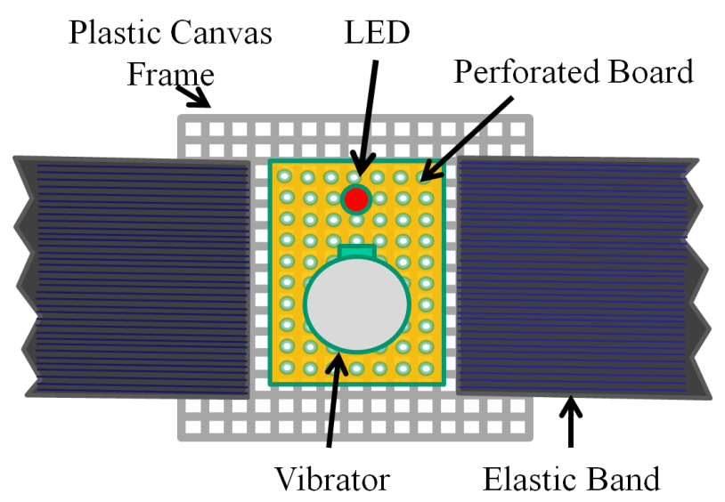
Enriching Interpersonal Human Interactions towards Effective Personal and Professional Communications
Sreekar Krishna^{†ǂ}, Bhavesh Patel ‡, & Sethuraman Panchanathan^{ǂ}
Motivation
Enriching Professional Communication
Medial Team Interactions in Critical Care
Social interactions are an essence of effective interpersonal communication.
Major portion of human communications happen through non-verbal cues.
People with sensory disabilities (persons who are blind or visually impaired) are at a loss when it comes to social interactions.
Even professional interactions require effective communication between participants.
Inability to communicate effectively in professional scenarios could prove costly.
1 Automated monitoring of group dynamics to determine communication breakdowns
Current team performance analysis systems are based on retrospective video stream analysis collected during simulations of hospital emergency codes. The analyses are mostly based on experts opinion of what happened during critical incidents of the simulation [6] [3]. Unfortunately, experts time is very valuable and post-simulation analysis may not get sufficient attention due to increased hospital load. For long, researchers have questioned how communication between medical team members vary over the period of the emergency code execution [2], but very little is understood on the basics of the communication patterns during emergency, mostly due to the lack of automated annotation system that does not require expensive specialist time. Automated team performance analysis systems that focus on detecting specific instances of communication breakdown occurring during code simulation could greatly enhance our understanding of team work and how it can be enhanced through training.
2 Automatic evaluation of the social affinity between team members
Sociograms (social affinity maps) have been used historically to determine the interpersonal match between members of a team or an organization. Sociograms are obtained through the process of sociometry [15], which quantitatively measures the relationships of individuals who exist within a social space. As mentioned earlier, in medical teams, the social space happens to be the emergency room where the team assembles with very little or no time to assess who are the members of the team. Sociometry is achieved through a set of evaluations that can assess the social interactions between individuals. The measurements could happen within the environment where the individuals interact (the medical team) or outside (casual interactions). Technologies developed to assess sociometric affinity between professionals could in turn provide quantitative evaluations of the social interactions between individuals. Sociograms developed at a hospital level could offer effective tools for quick team formations. Teams formed out of specialists, technicians and nurses who are closer to one another on the sociogram could offer a team with relatively less emotional stress. Socially closer individuals will also exhibit better communication, thereby increasing team performance.
3 Leadership evaluation and nomination through long term monitoring of individuals
Theories of leadership have proposed evidence-based models for explaining qualities exemplified in successful leaders. Recently, the functional model of leadership [7] has been developed to describe team leaders as having self regulation which translates to learning, performance and adaptability. These models allow studying of dynamic teams that are formed in very short durations (like medical response teams) and allow monitoring of each individual and their contribution to the group activity. Reference [7] also describes a dynamic multi-goal model for team leadership which models effective leaders as those who can not only assess their own goals but also keep track of team goals, while approaching a dynamically evolving situation. Technologies developed towards understanding and modeling human interactions and communications can provide the tools needed to measure leadership qualities through long term monitoring.
Social Situational Awareness
TeamSTEPPS: Importance of Team in Medical Emergencies
Based on an online web survey conducted with 16 persons who were blind, 9 with low vision and 2 sighted specialists in the area of visual impairment
Importance of human communication in medical teams and towards team performance and patient safety.
Goal: Design and Develop an human-human interaction enrichment tools that focuses on improving communications in personal and professional settings.
Enriching Personal Communication
Social Interaction Assistant for individuals who are visually impaired
References
[1] Balasubramanian V., Chakraborty S., Krishna S., Panchanathan S., Human-Centered Machine Learning in a Social Interaction Assistant for Individuals with Visual Impairments, Symposium on Assistive Machine Learning for People with Disabilities at Neural Information Processing Systems (NIPS), Dec 2009.
[2] Bergs E., Rutten F., Tadros T., Krijnen P., and Schipper I., Communication during trauma resuscitation: do we know what is happening?, Injury, vol. 36, 2005, 905-911.
[3] Carbine D. N., Finer N.N., Knodel E., and Rich W., Video recording as a means of evaluating neonatal resuscitation performance, Pediatrics, vol. 106, Oct. 2000, 654-658.
[4] Gade L., Krishna S., and Panchanathan S. Person localization using a wearable camera towards enhancing social interactions for individuals with visual impairment. 1 st ACM SIGMM international Workshop on Media Studies and Implementations that Help Improving Access To Disabled Users MSIADU 2009, 53-62.
[5] Humphrey N., Vision in a monkey without striate cortex: a case study, Perception, vol. 3, 1974, 241-255.
[6] Karlgren N., Dahlstr¨om A., and Ponzer S., Design of an Annotation Tool to Support Simulation Training of Medical Teams, Times of Convergence. Technologies Across Learning Contexts, 2008, 179-184.
[7] Kozlowski S.W.J., Gully S.M., McHugh P.P., Salas E., and Cannon-Bowers J.A., A dynamic theory of leadership and team effectiveness: Developmental and task contingent leader roles., Research in Personnel and Human Resources Management, G. Ferris, Ed., JAI Press, 1996, 252-305.
[8] Krishna S. and Panchanathan S., Combining Skin-Color Detector and Evidence Aggregated Random Field Models towards Validating Face Detection Results, in Indian Conference on Computer Vision, Graphics & Image Processing, 2008, 466-473.
[9] Krishna S., Bala S., McDaniel T., McGuire S., and Panchanathan S., VibroGlove: an assistive technology aid for conveying facial expressions, Proceedings of the 28th of the international CHI conference extended abstracts on Human factors in computing systems, Atlanta, Georgia, USA: ACM, 2010, 3637-3642.
[10] Krishna S., Balasubramanian V., Panchanathan S., Enriching Social Situational Awareness in Remote Interactions: Insights and Inspirations from Disability Focused Research, ACM MM 2010 Brave New Ideas Session, Oct 2010.
[11] Krishna S., McDaniel T. and Panchanathan S., Embodied Social Interaction Assistant, Technical Report #TR-10-001, Arizona State University, Tempe, 2010.
[12] Krishna S., Panchanathan S., Assistive Technologies as Effective Mediators in Interpersonal Social Interactions for Persons with Visual Disability, Computers Helping People with Special Needs, Austria: Springer, 2010, 316 - 323.
[13] Krishna S., Patel B., Studying Individuals and Groups Scoio-Emotional Artifacts in Medical Teams towards Improved Patient Safety: A TeamSTEPPS Approach, Technical Report #TR-10-009, Arizona State University, Tempe AZ USA July 2010.
[14] McDaniel T., Krishna S. and Panchanathan S., Using Tactile Rhythm to Convey Interpersonal Distances to Individuals who are Blind, Conference on Human Factors in Computing Systems, 2009, 4669-4674.
[15] Jennings H.H., Sociometry in group relations, 105th ed. (Washington): American Council on Education, 1959.
[16] N. Ambady and R. Rosenthal, Thin Slices of Expressive behavior as Predictors of Interpersonal Consequences : a Meta-Analysis, Psychological Bulletin, vol. 111, no. 2, pp. 274, 256, 1992.
Group Interaction Assistance
Detecting and intervening in asocial stereotypies like body rocking.
Detecting and delivering information on the social scene like number of people, where they are located etc.
Detecting eye contact made by sighted counterparts.
Recognizing individuals through facial biometrics.
Dyadic Interaction Assistance
Focused on the interaction partner’s face, head and upper body communicative gestures.
Detect and deliver facial expressions of interaction partners at user desired level of granularity.
Detect and deliver communicative gestures such as head shake, head nod, etc.
Detect and deliver intent information such and lean back, lean in, etc.
Sensing Element
Accelerometer
Shaftless Vibration Motor
Hardware
1.3 Megapixel Digital Camera
User Interface
Atmel ATmega168 μC
Darlington Motor Driver
μC Programming Port
Haptic Belt
USB-Serial Interface
Debug Port LED
Processing Element
Individual Vibrator
† Contact Author: Sreekar Krishna, CUbiC: http://cubic.asu.edu/, Arizona State University, Tempe, AZ. Ph: (480) 727-3612 Fax: (480) 965-1885 Email: Sreekar.Krishna@asu.edu Website: www.sreekarkrishna.com
^{ǂ} Arizona State University, Tempe AZ 85281
‡ Mayo Clinic Hospital, Phoenix AZ 85054

